Slide 1

Incident Impact Prediction
Group: 4
Dhanya GD
Macchindra Ganpat Shinde
Vikas Bhagwan Chaudhari
Rahul Kumar
Sourajit Dey
Nithish Kumar CV
Mentor: Parth Sagar
Date: 10/02/2022

Slide 2
Business Problem:
To predict the impact of the incident raised by the customer.
Objective:
Whenever a service being provided to the customer is disrupted, the customer raises a complaint to the customer service; who in turn raises a ticket.
When an incident is logged, a lot of data related to the incident is recorded for ex: time, status …
Our objective is to predict the impact of an incident i.e whether it is High, Medium or Low. So that the company can optimize the resource allocation to focus on the important incidents.
A quicker resolution translates to customer satisfaction/retention which leads to better business.

Slide 3
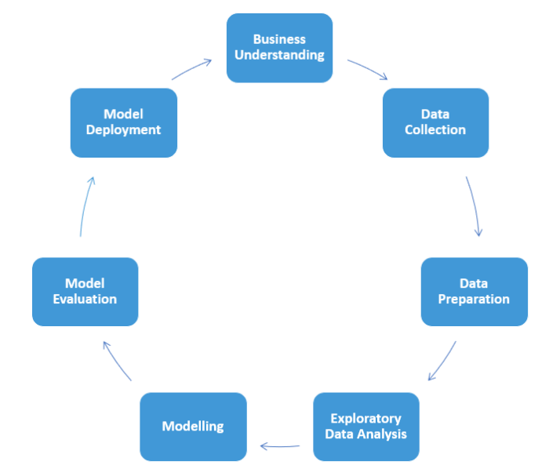
Project Architecture

Slide 4
Project Flow
Understanding the business problem.
Data collection
Data preparation.
EDA and Feature Engineering
Model building
Model training and evaluation
Deployment

Slide 5
Exploratory Data Analysis (EDA)

Slide 6
Exploratory Data Analysis (EDA)
Dataset details:
The dataset has 141712 records, 36 columns with ‘impact’ column as target.
column type | No of columns
Numeric columns | 3
Boolean columns | 5
Categorical columns | 23
Datetime columns | 5
Total | 36
Notes:
['cmdb_ci', 'problem_id', 'rfc', 'vendor', 'caused_by', 'sys_created_by', 'sys_created_at'] # u_symptom
sys_created_by
53076
37
11
sys_created_at

Slide 7
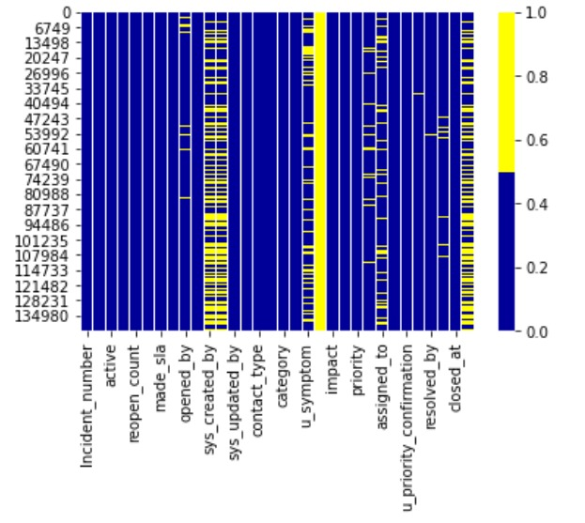
Null values:
Null values recorded as ‘?’ (mostly) and ‘-100’.
Columns with more than 98% missing values: 'cmdb_ci', 'problem_id', 'rfc', 'vendor', 'caused_by'.
‘sys_created_by’ and ‘sys_created_at’ have 37% null values.
Notes:
Heatmap unable to accommodate all columns

Slide 8
Null values by column:
col_name | null_vals | % percentage of null vals
opened_by | 4835 | 3
sys_created_by | 53076 | 37
sys_created_at | 53076 | 37
u_symptom | 32964 | 23
cmdb_ci | 141267 | 100
assignment_group | 14213 | 10
assigned_to | 27496 | 19
problem_id | 139417 | 98
rfc | 140721 | 99
vendor | 141468 | 100
caused_by | 141689 | 100
closed_code | 714 | 1
resolved_at | 3141 | 2

Slide 9
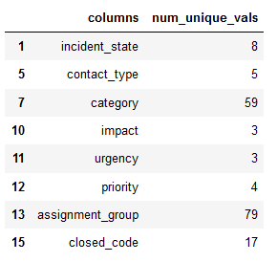
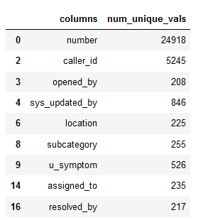
Unique values:
Mix of high and low cardinality columns.
Unique values < 100
Unique values > 100

Slide 10
Assumptions / Queries:
Date and time columns may affect our target variable.
‘incident no’ may not affect target.
‘opened_by’ may not affect the target.
‘opened at’ - should be investigated further.
Does location of incident affect the impact colum?
Does contact type (phone, email etc.) affect impact column?
Does ‘u_symptom affect’ the impact column?
Having a prior knowledge of the incident may lead to quicker resolution and may have a relation to impact.

Slide 11
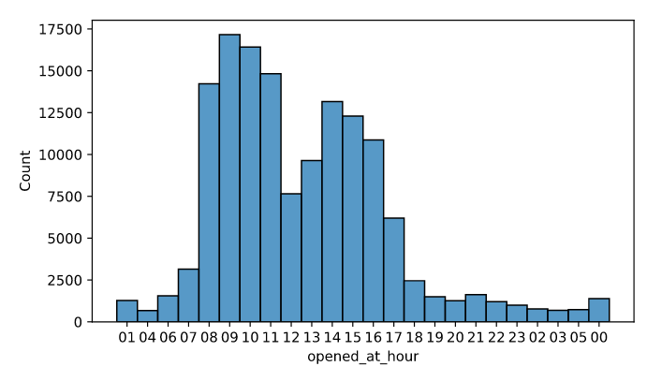
On splitting the ‘opened_at’ column into date and time, we observe that most of the incidents get reported during
8:00 hrs to 17:00 hrs

Slide 12
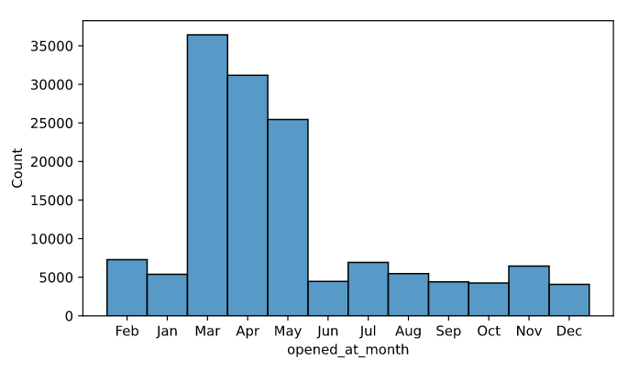
On splitting the ‘opened_at’ column into months, we observe that most of the incidents get reported during during months of march , april, and may.

Slide 13
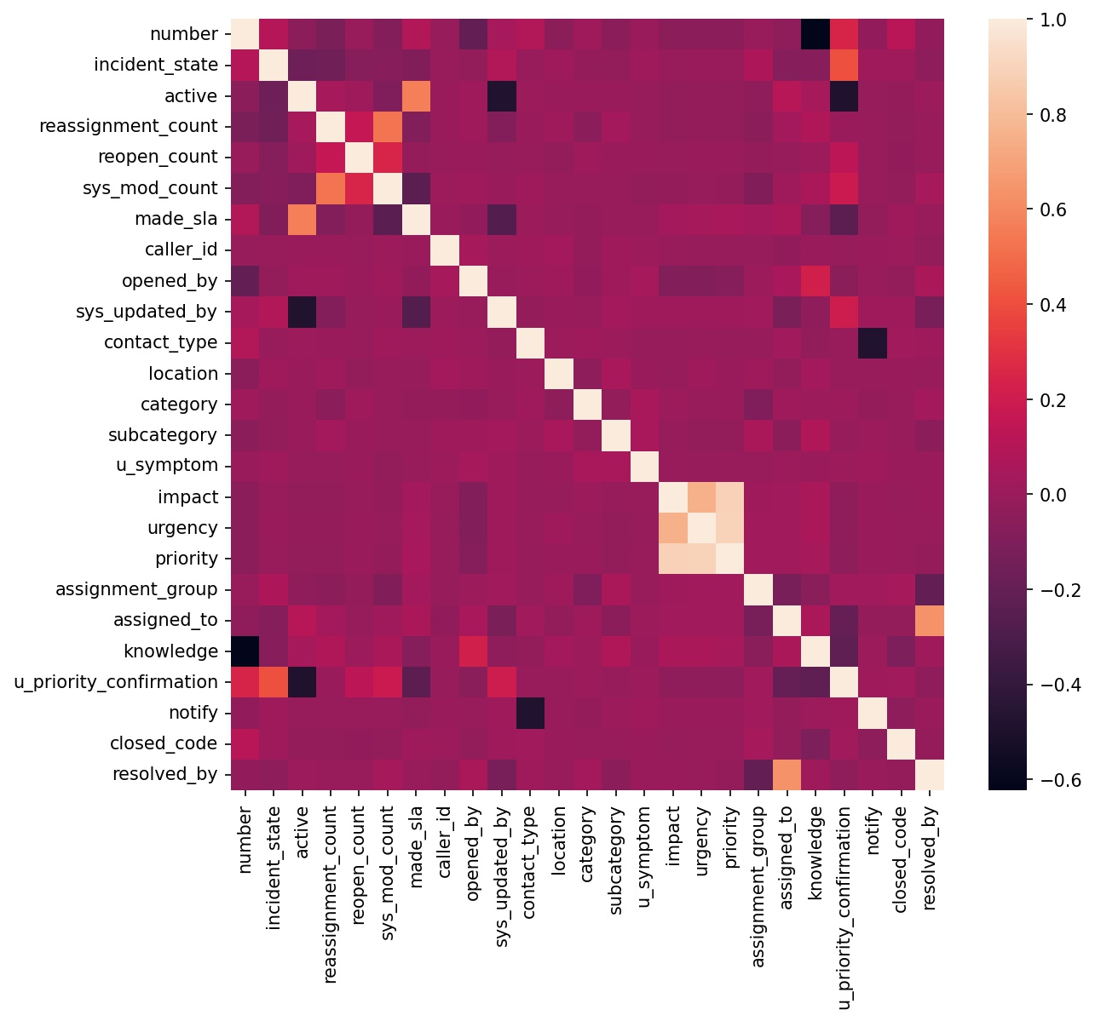
From the heatmap we see that except for ‘urgency’ and ‘priority’ none of the other features have a strong correlation with the target.
There are few strong correlations between feature columns.

Slide 14
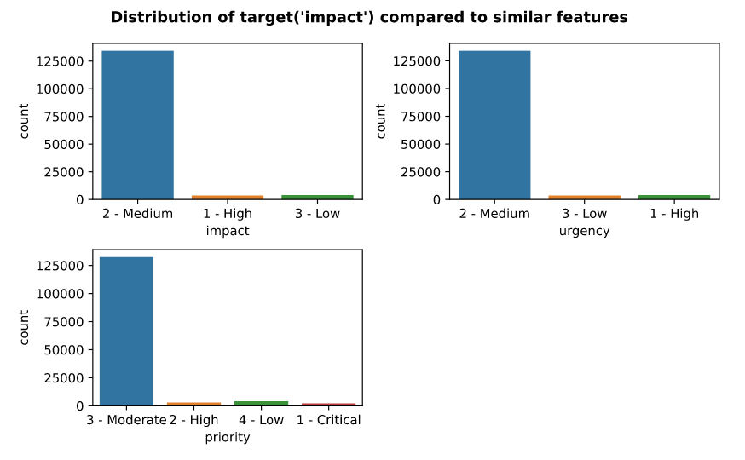
We observe that the target distribution is imbalanced with most of the incidents classified as having a ‘Medium’ impact.
The columns ‘urgency’ and ‘priority’ follow a similar trend.

Slide 15
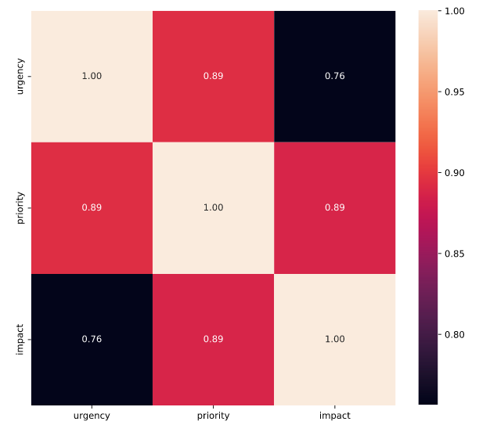
Relationship between ‘urgency’, ‘Priority’ and ‘Impact:
The above columns are very highly correlated with ‘impact’. Will these two features play a dominant role in predictions?

Slide 16
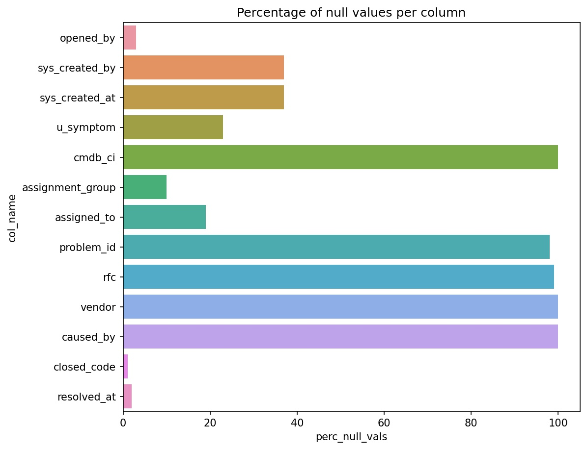
Feature Engineering
Drop the columns with most null values:
The following columns have more than 35% null values and can
be dropped:
'cmdb_ci', 'problem_id', 'rfc', 'vendor', 'caused_by', 'sys_created_by', 'sys_created_at'

Slide 17
Imputing Null values:
The following columns have fewer null values and will be imputed as described below.
COLUMN NAME | IMPUTED VALUE | IMPUTATION STRATEGY
'caller_id' | Mode | Mode
'opened_by' | Mode | Mode
'location' | Mode | Mode
'category' | Mode | Mode
'subcategory' | Mode | Mode
'u_symptom' | Mode | Mode
'assignment_group' | Mode | Mode
'assigned_to' | Mode | Mode
'resolved_by' | Mode | Mode
'incident_state' | Mode | Mode
‘closed_code’ | - | padding

Slide 18
Encoding Categorical columns:
Columns with boolean categories converted to 0 and 1.
COLUMN | LABELS | BOOL CATEGORY
'active' | TRUE, FALSE | TRUE-1, FALSE-0
'made_sla' | TRUE, FALSE | TRUE-1, FALSE-0
'knowledge' | TRUE, FALSE | TRUE-1, FALSE-0
'u_priority_confirmation' | TRUE, FALSE | TRUE-1, FALSE-0
'notify' | 'Send Email', Do Not Notify | Do Not Notify-0, 'Send Email'-1
Columns with more than two labels encoded using ordinal encoder.

Slide 19
Extracted features from columns having datetime data
Features like ‘Year’ , ‘Month’, ‘Week’, ‘Day’, ‘Hour’, ‘Minute’ were extracted from the datetime features.

Slide 20
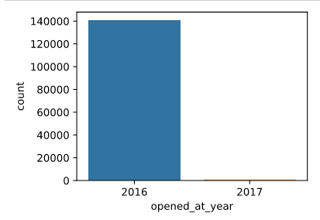
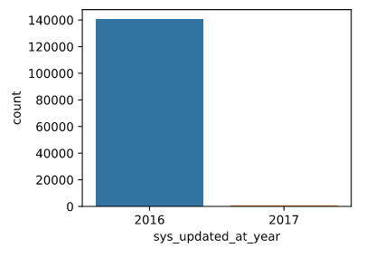
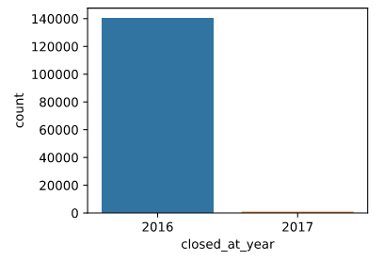
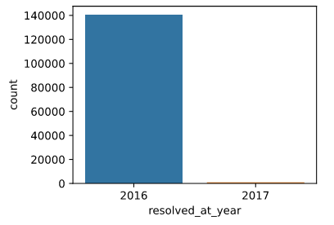
Year wise extracted features

Slide 21
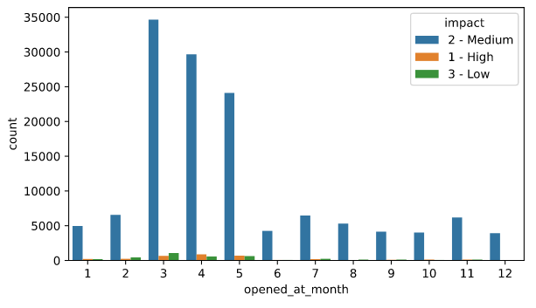
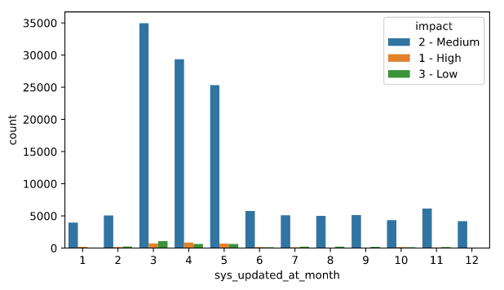
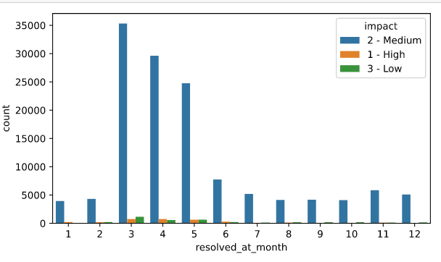
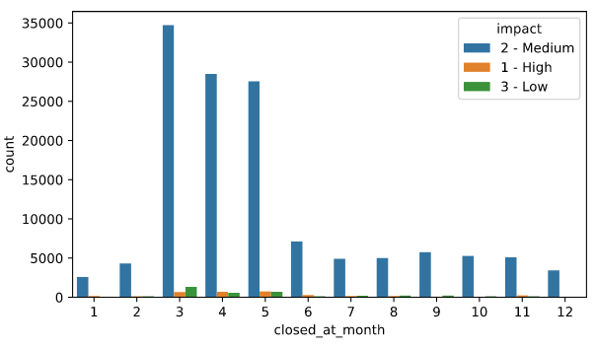
Month wise extracted features

Slide 22
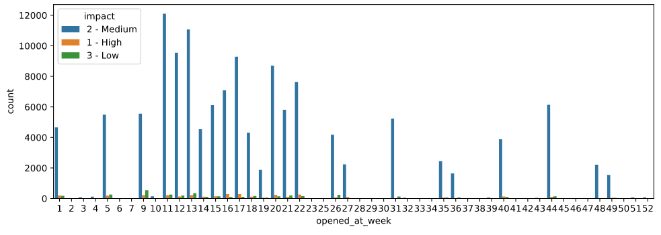
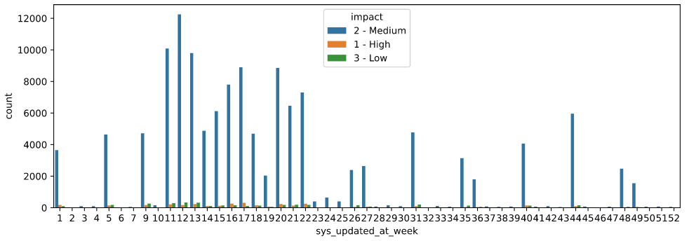
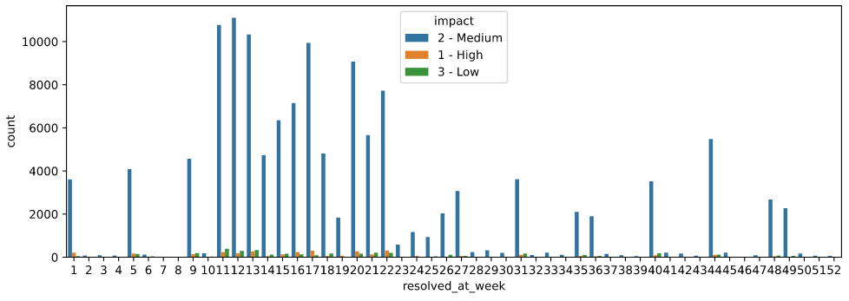
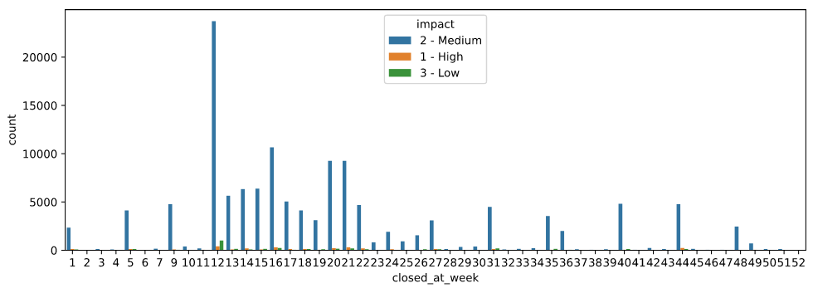
Week wise extracted features

Slide 23
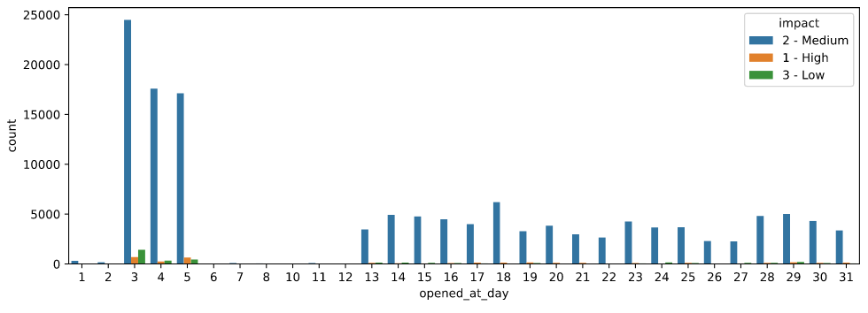
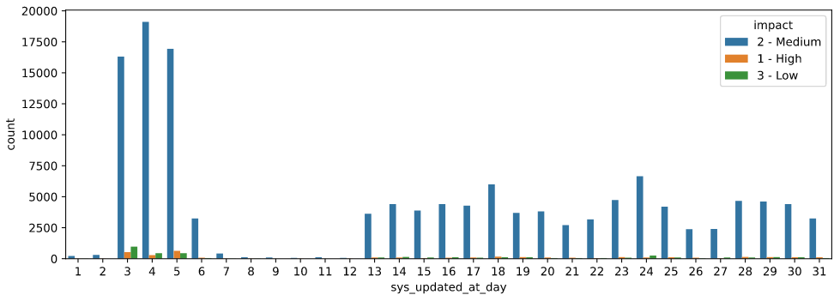

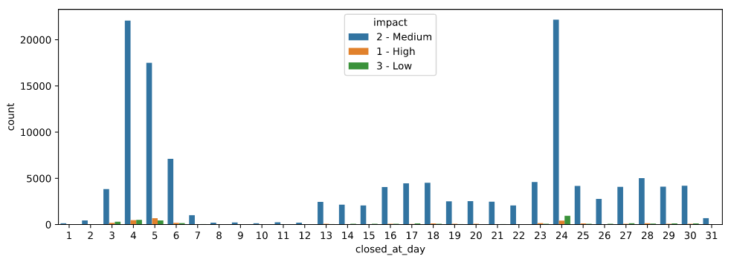
Day wise extracted features

Slide 24
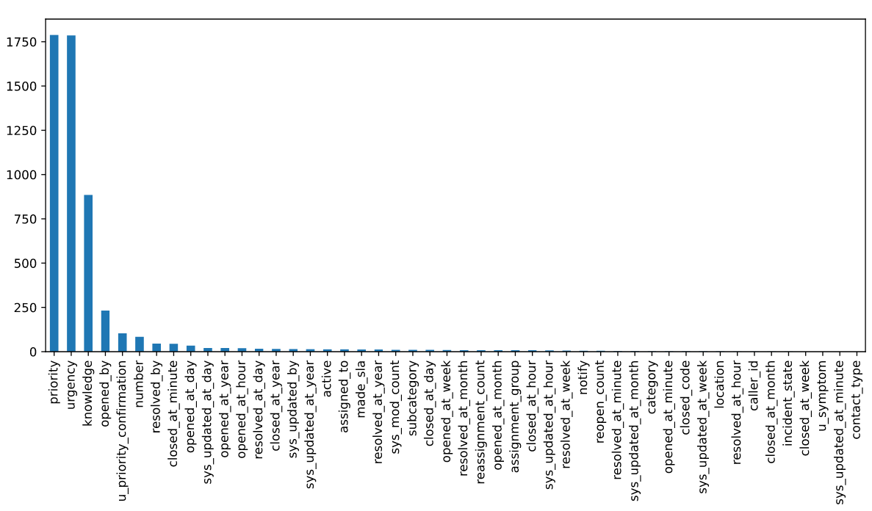
Feature selection using Chi-Square and KBest
Features selected:
'urgency', 'priority', 'knowledge', 'opened_by', 'u_priority_confirmation', 'number' , 'closed_at_minute', 'resolved_by', 'opened_at_day', 'assigned_to', 'sys_updated_at_day', 'opened_at_hour', 'resolved_at_day'

Slide 25
Mutual information classification:
Features selected :
‘active', 'made_sla', 'urgency', 'priority', 'contact_type', 'category', 'assignment_group', 'number', 'caller_id', 'opened_by', ’'sys_updated_by', 'subcategory', 'u_symptom', 'assigned_to', 'resolved_by'.

Slide 26
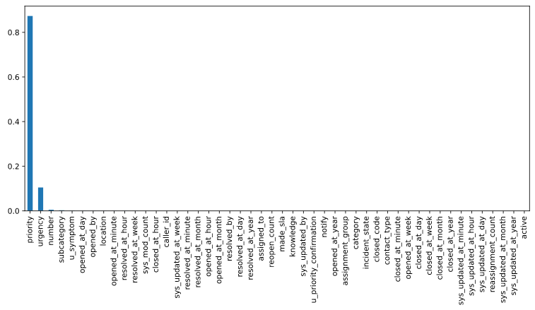
Feature importance using decision trees:
Features selected :
'priority', 'urgency', 'number', 'subcategory', 'u_symptom',
'opened_at_day', 'opened_by', 'location', 'opened_at_minute',
‘resolved_at_hour', 'resolved_at_week', 'sys_mod_count', closed_at_hour'

Slide 27
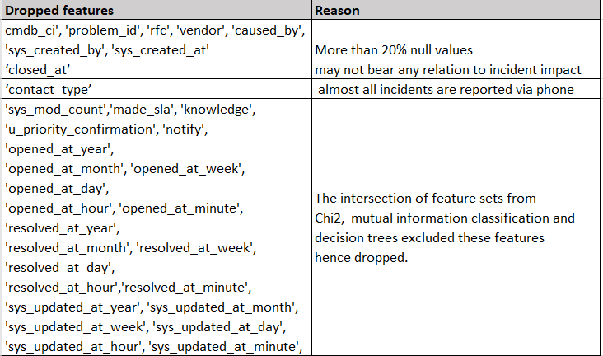
list of features removed:.
list of features selected:
'priority', 'opened_by', 'number', 'urgency'

Slide 28
Model Building

Slide 29
Experimenting with different models:
Classification reports and confusion matrices

Slide 30
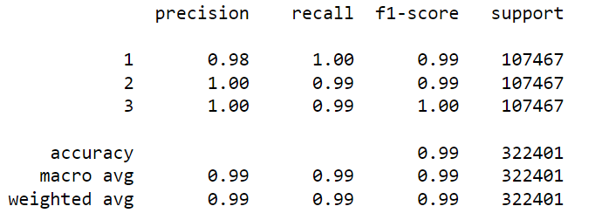
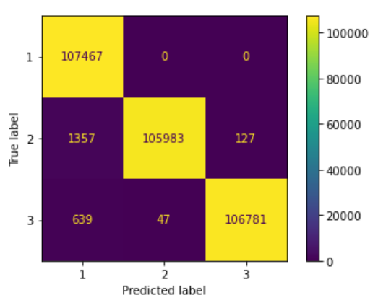
Gaussian naive bayes: Train data

Slide 31
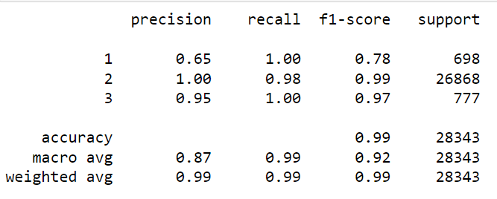
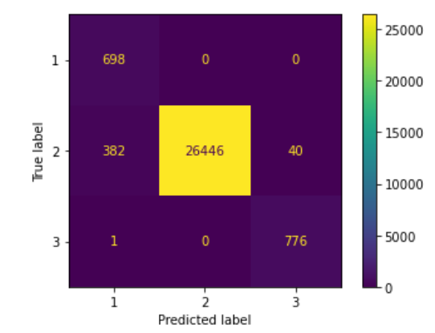
Gaussian Naive bayes: Test data

Slide 32
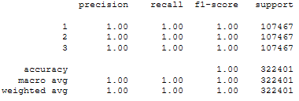
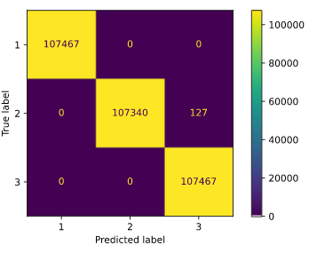
Logistic regression: Train data

Slide 33
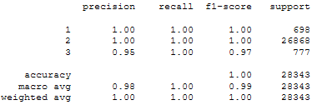
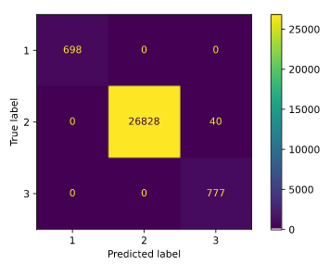
Logistic regression: Test data

Slide 34
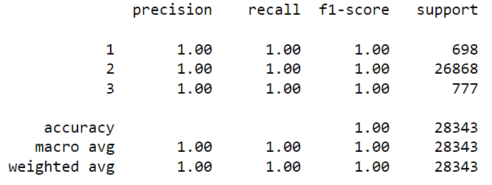
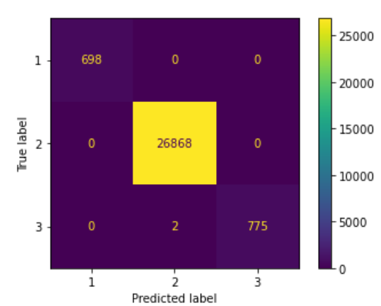
Decision tree: Train data

Slide 35
Decision tree: Test data

Slide 36
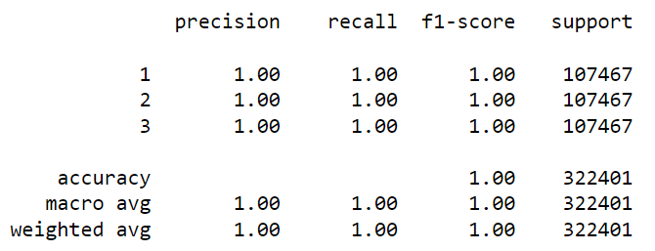
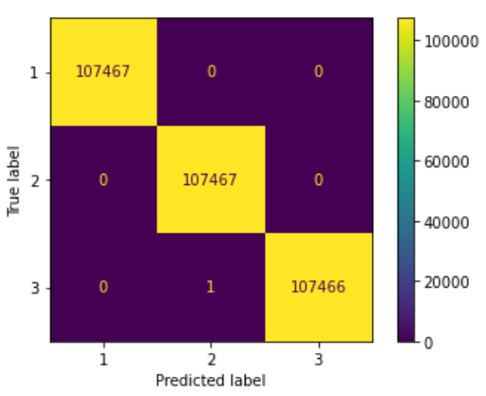
Random forest: Train data

Slide 37
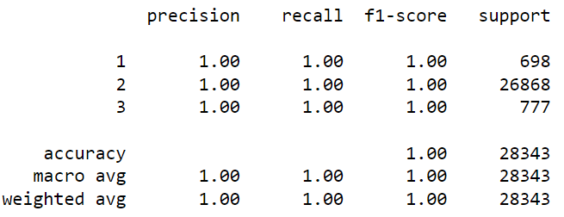
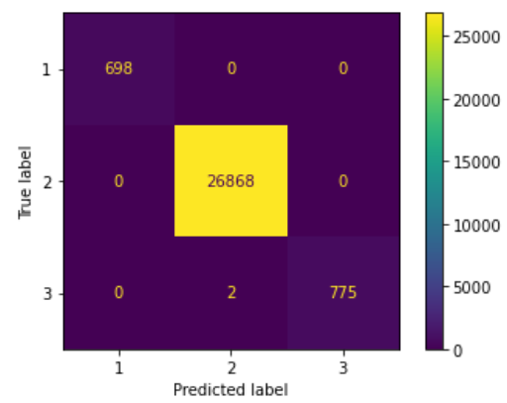
Random forest: Test data

Slide 38
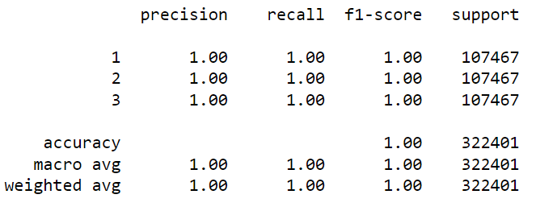
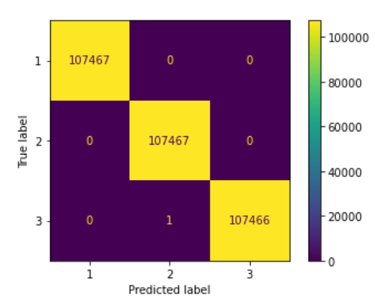
XGBoost: train data

Slide 39
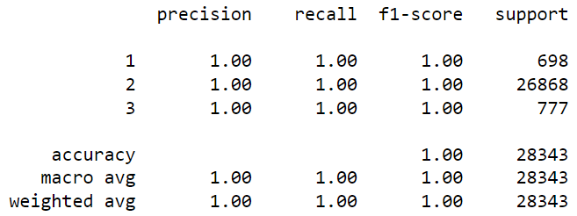
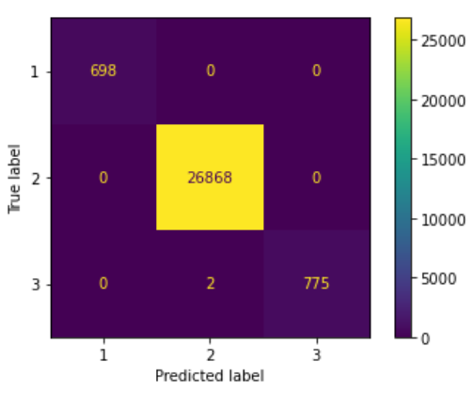
XGBoost: Test data

Slide 40
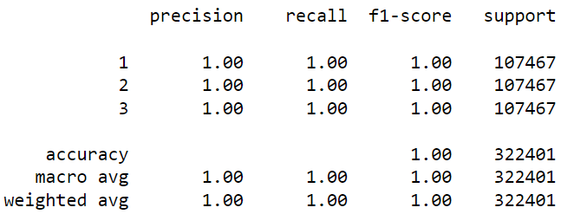
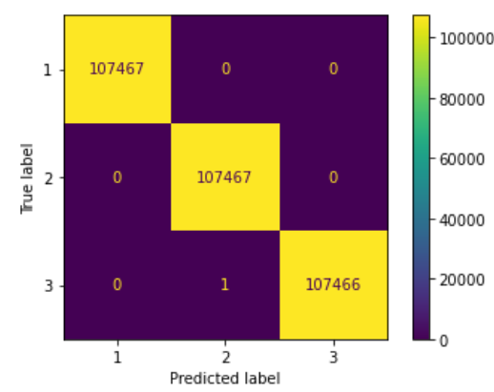
KNN: Train data

Slide 41
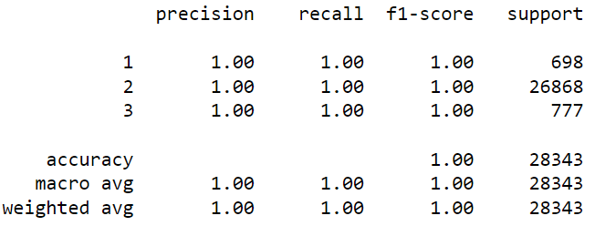
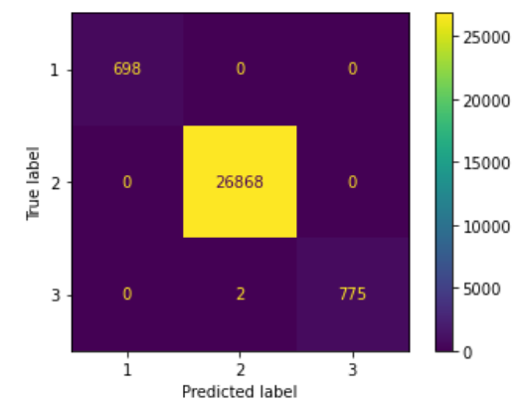
KNN: Test data

Slide 42


SVM: Train data

Slide 43


SVM: Test data

Slide 44

Summary of results for all the models:
A weighted average of all the precision, recall , F1 score and accuracy is reported for each of the models mentioned.

Slide 45

Final model and results
Model - Random Forest
Data set details:
features - categorical and numeric
target - ‘Impact’
Algorithm details and configuration:
Data preprocessing
Feature engineering + selection
Random forest - chosen for stability and performance
No hyper parameters added
Data Partition details:
Train - 80%
Test - 20%

Slide 46
Possible Reasons for high accuracy (1 in all case)
Urgency: Depending on the nature of the issue and after identifying the nature of impact, a decision is taken on how soon the issue is to be fixed. Impact severity is directly proportional to urgency.
Priority: Priority is fixed depending on the business service. Incident priority can be upgraded or downgraded based on the severity of the incident
Impact: It is decided based in terms of damage caused to business, type of customers impacted based on location and varies from business to business.
All three are directly related to each other.
Note: All possible ways for information leakage was checked and it was found that the same did not happen.

Slide 47

Model Predictions
Model: Random forest
Actual
impact
value
Predicted impact for each transaction
Transaction data fed to the model

Slide 48
Model Results
Model: Random forest
698 correct predictions for ‘High impact’.
26868 correct predictions for ‘Moderate impact’.
775 correct predictions and 2 incorrect predictions for ‘Low impact’

Slide 49
Model Deployment using Streamlit

Slide 50

Incident Impact Prediction - Web App
Link: https://share.streamlit.io/niti42/incident_impact_v1.1/main/incident_pred_app_v1.1.py

Slide 51

Incident Impact Prediction
with sample data

Slide 52
Challenges faced?
Dominance of categorical features.
Ambiguity in representation of null values.
Date time features recorded using object datatype and had few null values.
poor correlation between features and target except for a few features.
imbalanced dataset.
How did you overcome?
Categorical features encoded with appropriate encoding techniques.
All ambiguous cases considered as null values after multiple discussions with team, mentor and some analysis.
Date time features converted to correct datatypes and appropriate features extracted.
Poor correlations - Used feature selection techniques to eliminate unwanted features and consulted with a subject expert to verify if the finalized features were really important for predictions.
Imbalanced dataset - Used SMOTE for balancing the dataset but performance was same with/without SMOTE.

Slide 53
Thank you

